Slide 1
Learning Python with
CS Circles, CEMC’s Amazing Online Tool for Students (lab)
Peter Beens
@pbeens
pbeens@gmail.com

Slide 2
https://goo.gl/ZEeg1t

Slide 3
www.acse.net

Slide 4
2.5 hours =
0.25 hours (max) talk +
2.25 hours play

Slide 5
Fantastic, interactive tool for learning Python 3
All you need is your web browser (Python does not need to be installed)
“Guru” feature allows you to monitor your students’ progress and assist them remotely
Self-paced, for students with differing abilities
Text is written in plain, non-academic language (i.e., for novices)
Ideal for flipped classroom use (lessons at home, practical work at school)
The technical support is fantastic!
Why CS Circles?

Slide 6
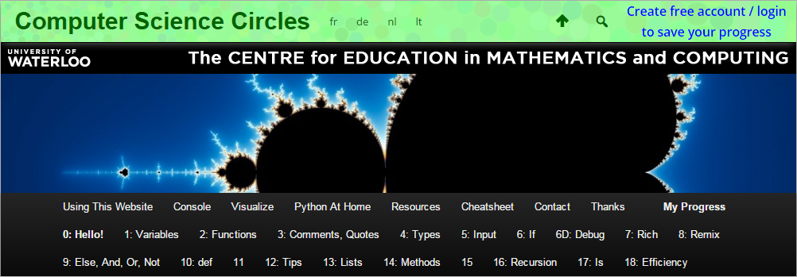
Overview of CS Circles Concepts

Slide 7
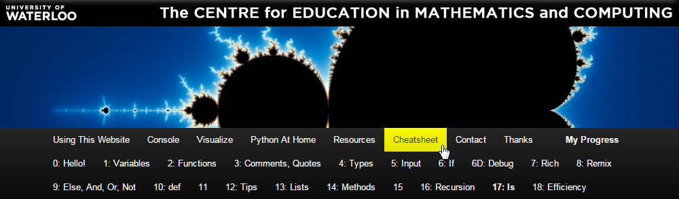
Keep the cheatsheet open in another tab as you learn!

Slide 8
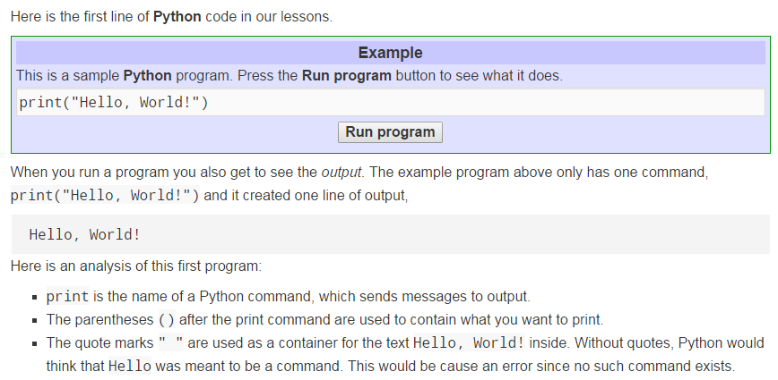
Lots of easy-to-understand explanations to learn the basics

Slide 9
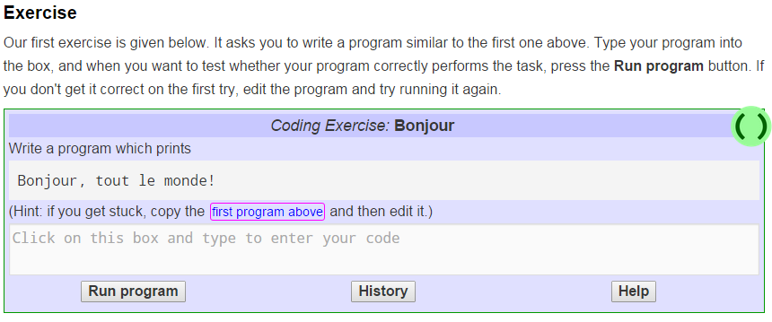
Lots of exercises to develop skills

Slide 10
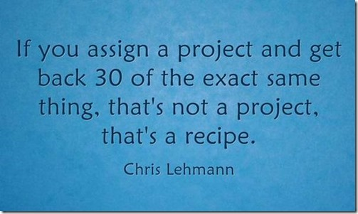
(graphic from Alfred Thompson’s blog post entitled “Projects and Recipes in Computer Science Classes” at http://goo.gl/iQjFQc)

Slide 11
http://www2.beens.org/ics/python/cs-circles-tutorial
(http://goo.gl/QyGFKF)
My approach to keeping CS Circles from being too much like a recipe...

Slide 12
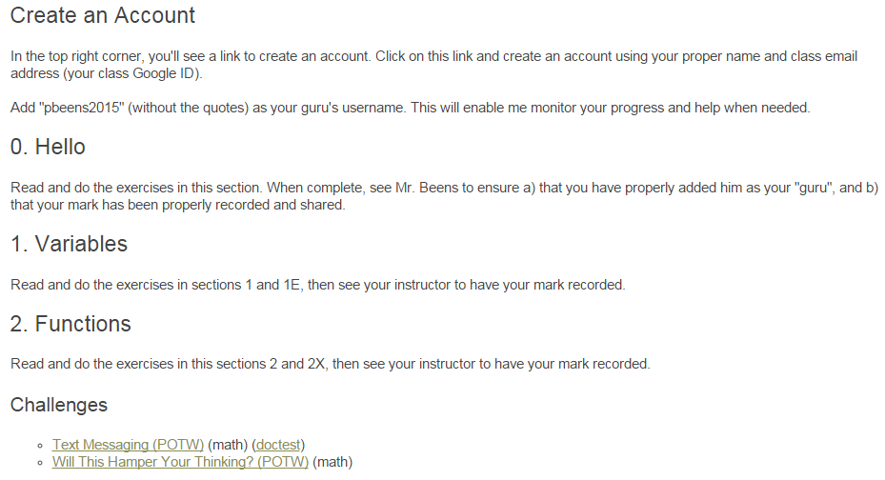
From my website -- typical instructions for my students. Note the additional challenges.

Slide 13
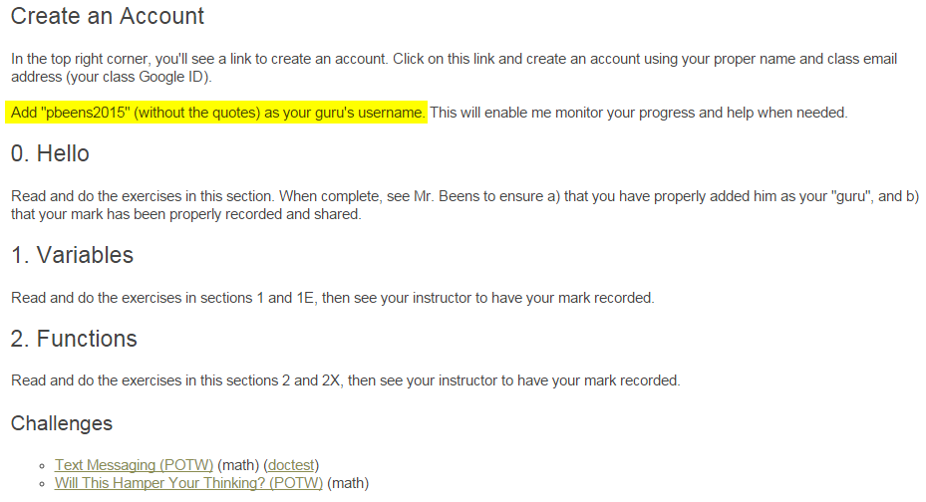
Students adding you as “guru” lets you monitor and assist them.

Slide 14
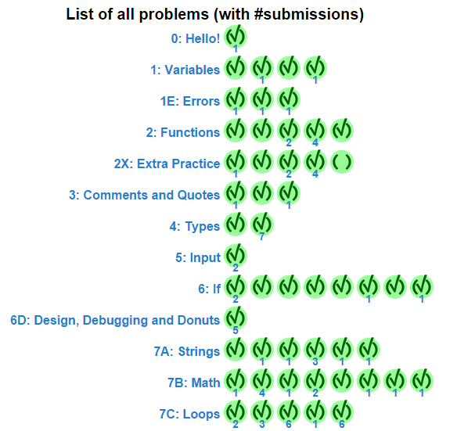

Slide 15
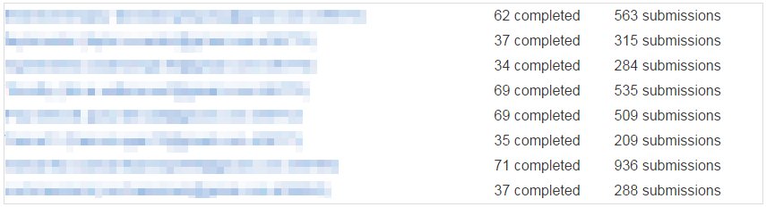

Slide 16
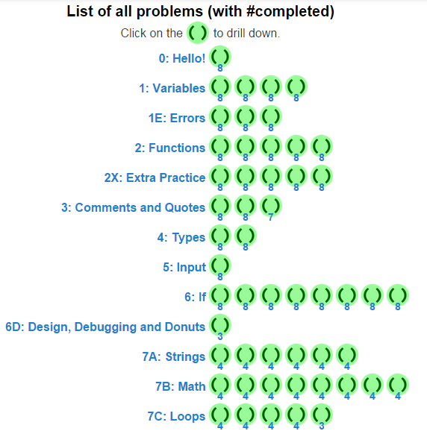

Slide 17
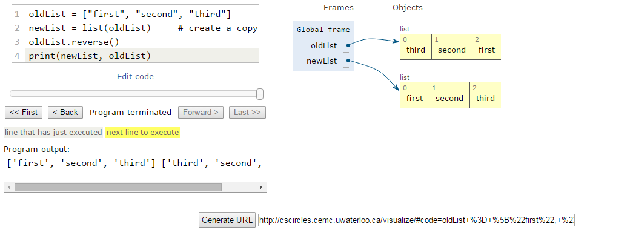
Excellent visualizer

Slide 18
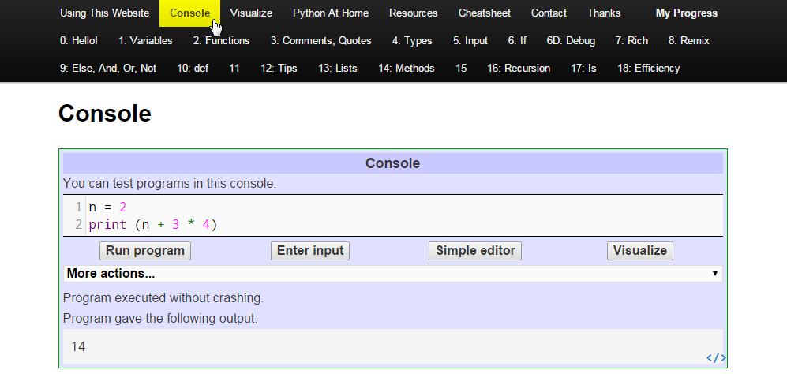
Console lets you try (and visualize) your own test programs

Slide 19
Time to play!
http://cscircles.cemc.uwaterloo.ca (http://goo.gl/YfWMYa) (or Google “CS Circles”)
Create an account to track your progress, and optionally add pbeens2015 as your guru (can be changed or removed later
This presentation (with links) can be found at http://www2.beens.org/teacher-pd/cs-circles-2015 (http://goo.gl/Hvn2ip)

